Slide 1
Intro to Design Patterns
SSW345

Slide 2
Outline
A Java Puzzler
Introduction to design patterns
Strategy pattern

Slide 3

“Time for a Change” (2002)
If you pay $2.00 for a gasket that costs
$1.10, how much change do you get?
public class Change {
public static void main(String args[]) { System.out.println(2.00 - 1.10);
}
}
From An Evening Of Puzzlers by Josh Bloch

Slide 4
What does it print?
0.9
0.90
It varies
None of the above
public class Change {
public static void main(String args[]) { System.out.println(2.00 - 1.10);
}
}

Slide 5
What does it print?
(a) 0.9
0.90
It varies
None of the above: 0.8999999999999999
Decimal values can't be represented exactly by float or double

Slide 6
Another look
public class Change {
public static void main(String args[]) { System.out.println(2.00 - 1.10);
}
}

Slide 7
How do you ﬁx it?
// You could fix it this way... import java.math.BigDecimal; public class Change {
Prints 0.90
public static void main(String args[]) { System.out.println(
new BigDecimal("2.00").subtract( new BigDecimal("1.10")));
}
}
// ...or you could fix it this way
public class Change {
Prints 90
public static void main(String args[]) { System.out.println(200 - 110);
}
}

Slide 8
The moral
Avoid float and double where exact answers are required
– For example, when dealing with money
Use BigDecimal, int, or long instead

Slide 9
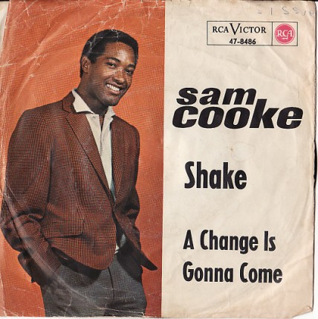
2. “A Change is Gonna Come”
If you pay $2.00 for a gasket that costs
$1.10, how much change do you get?
import java.math.BigDecimal;
public class Change {
public static void main(String args[]) { BigDecimal payment = new BigDecimal(2.00); BigDecimal cost = new BigDecimal(1.10); System.out.println(payment.subtract(cost));
}
}

Slide 10
What does it print?
0.9
0.90
0.8999999999999999
(d) None of the above
import java.math.BigDecimal;
public class Change {
public static void main(String args[]) { BigDecimal payment = new BigDecimal(2.00); BigDecimal cost = new BigDecimal(1.10); System.out.println(payment.subtract(cost));
}
}

Slide 11
What does it print?
0.9
0.9
0.8999999999999999
( d ) None of the above:
0.899999999999999911182158029987476766109466552734375

Slide 12
Another look
The spec says:
public BigDecimal(double val)
Translates a double into a BigDecimal which is the exact decimal representation of the double's binary ﬂoating-point value.
import java.math.BigDecimal; public class Change {
public static void main(String args[]) { BigDecimal payment = new BigDecimal(2.00); BigDecimal cost = new BigDecimal(1.10); System.out.println(payment.subtract(cost));
}
}

Slide 13
How do you ﬁx it?
import java.math.BigDecimal;
Prints 0.90
public class Change {
public static void main(String args[]) { BigDecimal payment = new BigDecimal("2.00"); BigDecimal cost = new BigDecimal("1.10"); System.out.println(payment.subtract(cost));
}
}

Slide 14
The moral
Use new BigDecimal(String), not new BigDecimal(double)
BigDecimal.valueOf(double) is better, but not perfect
Use it for non-constant values.
For API designers
Make it easy to do the commonly correct thing
Make it possible to do exotic things

Slide 15
Using delegation to extend functionality
The LoggingList is composed of
a List, and delegates (the non-
One solution:
logging) functionality to that List
public class LoggingList<E> implements List<E> { private final List<E> list;
public LoggingList<E>(List<E> list) { this.list = list; } public boolean add(E e) {
System.out.println("Adding " + e); return list.add(e);
}
public E remove(int index) { System.out.println("Removing at " + index); return list.remove(index);
}
…

Slide 16
Implementation inheritance for code reuse
public abstract class AbstractAccount implements Account {
protected long balance = 0;
public long getBalance() { return balance;
}
abstract public void monthlyAdjustment();
// other methods…
}
public class CheckingAccountImpl extends AbstractAccount implements CheckingAccount {
public void monthlyAdjustment() { balance -= getFee();
}
public long getFee() { … }
}

Slide 17
Design with inheritance (or not)
Favor composition over inheritance
Inheritance violates information hiding
Design and document for inheritance, or prohibit it
Document requirements for overriding any method

Slide 18
Behavioral subtyping
Let q(x) be a property provable about objects x of type T. Then q(y) should be provable for objects y of type S where S is a subtype of T.
Barbara Liskov
e.g., Compiler-enforced rules in Java:
Subtypes can add, but not remove methods
Concrete class must implement all undeﬁned methods
Overriding method must return same type or subtype
Overriding method must accept the same parameter types
Overriding method may not throw addi9onal excep9ons
Also applies to speciﬁed behavior:
Same or stronger invariants
Same or stronger postconditions for all methods
Same or weaker preconditions for all methods
This is called the Liskov Substitution Principle.
Notes:
Role Subtype: How do you represent the many roles of an object? Make a subtype for each role. Put common behavior in the supertype3Conceptually simple3Interface is simple 7Cannot directly implement if there are multiple or changing roles7Each new role causes the interface of the supertype to change

Slide 19
Behavioral subtyping (Liskov Substitution Principle)
class Rectangle {
//@ invariant h>0 && w>0;
int h, w;
class Square extends Rectangle {
//@ invariant h>0 && w>0;
//@ invariant h==w; Square(int w) {
super(w, w);
}
}
Rectangle(int h, int w) { this.h=h; this.w=w;
}
//@ requires factor > 0; void scale(int factor) {
w=w*factor; h=h*factor;
}
}
Is this Square a behavioral subtype of Rectangle? (Yes.)

Slide 20
Behavioral subtyping (Liskov Substitution Principle)
class Rectangle {
//@ invariant h>0 && w>0;
int h, w;
class Square extends Rectangle {
//@ invariant h>0 && w>0;
//@ invariant h==w; Square(int w) {
super(w, w);
}
}
Rectangle(int h, int w) { this.h=h; this.w=w;
}
//@ requires factor > 0; void scale(int factor) {
w=w*factor; h=h*factor;
}
//@ requires neww > 0;
void setWidth(int neww) { w=neww;
}
Is this Square a behavioral subtype of Rectangle?
}

Slide 21
Behavioral subtyping (Liskov Substitution Principle)
class Rectangle {
//@ invariant h>0 && w>0;
int h, w;
class Square extends Rectangle {
//@ invariant h>0 && w>0;
//@ invariant h==w; Square(int w) {
super(w, w);
}
}
Rectangle(int h, int w) { this.h=h; this.w=w;
}
//@ requires factor > 0; void scale(int factor) {
w=w*factor; h=h*factor;
}
//@ requires neww > 0;
void setWidth(int neww) { w=neww;
}
← Invalidates stronger
invariant (w==h) in subclass
Yes?! (But the Square is not a square…)
}

Slide 22
Outline
A Java Puzzler
Introduction to design patterns
Strategy pattern

Slide 23
One design scenario
Amazon.com processes millions of orders each year, selling in 75 countries, all 50 states, and thousands of cities worldwide. These countries, states, and cities have hundreds of distinct sales tax policies and, for any order and destination, Amazon.com must be able to compute the correct sales tax for the order and destination.

Slide 24
Another design scenario
A vision processing system must detect lines in an image. For diﬀerent applications the line detection requirements vary. E.g., for a vision system in a driverless car the system must process 30 images per second, but it's OK to miss some lines in some images. A face recognition system can spend 3-5 seconds analyzing an image, but requires accurate detection of subtle lines on a face.

Slide 25
A third design scenario
Suppose we need to sort a list in diﬀerent orders…
interface Comparator {
boolean compare(int i, int j);
}
final Comparator ASCENDING = (i, | j) -> | i < j;
final Comparator DESCENDING = (i, | j) -> | i > j;
static void sort(int[] list, Comparator cmp) {
…
boolean mustSwap = cmp.compare(list[i], list[j]);
…
}

Slide 26
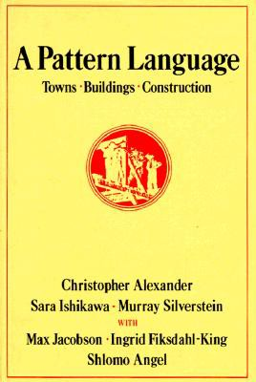
Design patterns
“Each pattern describes a problem which occurs over and over again in our environment, and then describes the core of the solution to that problem, in such a way that you can use this solution a million times over, without ever doing it the same way twice”
– Christopher Alexander, Architect (1977)

Slide 27
How not to discuss design (from Shalloway and Trott)
Carpentry:
How do you think we should build these drawers?
Well, I think we should make the joint by cutting straight down into the wood, and then cut back up 45 degrees, and then going straight back down, and then back up the other way 45 degrees, and then going straight down, and repeating…
Software Engineering:
How do you think we should write this method?
I think we should write this if statement to handle … followed by a while loop … with a break statement so that…

Slide 28
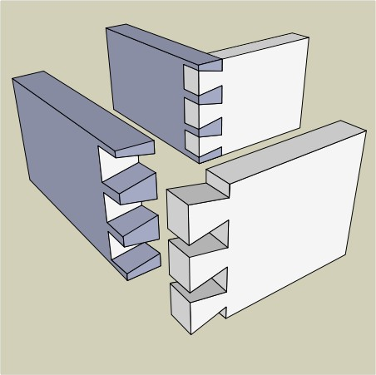

Discussion with design patterns
Carpentry:
"Is a dovetail joint or a miter joint better here?"
Software Engineering:
"Is a strategy pattern or a template method better here?"

Slide 29
History: Design Patterns (1994)

Slide 30
Elements of a design pattern
Name
Abstract description of problem
Abstract description of solution
Analysis of consequences

Slide 31
Strategy pattern
Problem: Clients need diﬀerent variants of an algorithm
Solution: Create an interface for the algorithm, with an implementing class for each variant of the algorithm
Consequences:
Easily extensible for new algorithm implementations
Separates algorithm from client context
Introduces an extra interface and many classes:
Code can be harder to understand
Lots of overhead if the strategies are simple

Slide 32
Patterns are more than just structure
Consider: A modern car engine is constantly monitored by a software system. The monitoring system must obtain data from many distinct engine sensors, such as an oil temperature sensor, an oxygen sensor, etc. More sensors may be added in the future.

Slide 33
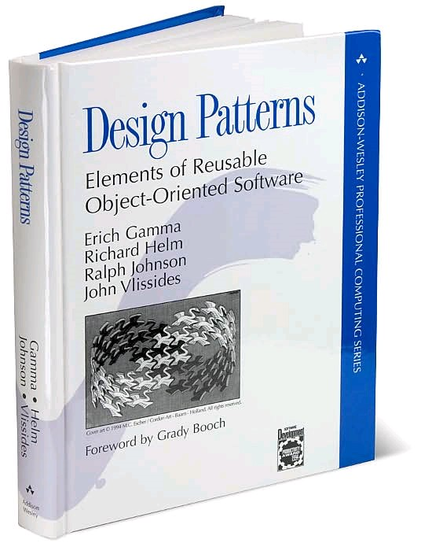
Design pattern conclusions
Provide shared language
Convey shared experience
Can be system and language speciﬁc

